Slide 1
Two-Dimensional Arrays and Nested Loops – part 6
Barb Ericson
Georgia Institute of Technology
August 2005

Slide 2
Learning Goals
Understand at a conceptual and practical level
  How can you make a picture smaller
    Scale it down
  How can you make a picture bigger
    Scale it up
  How do you create a collage?

Slide 3
Scaling
You can make a picture smaller
  Faster to download on the web
    Increment the source x and y by a number larger than 1
      Don’t use all the source pixels in target
You can make a picture larger
  Show more detail
    Copy the same source x and y to more than one target x and y
      Use source pixels more than once in target

Slide 4
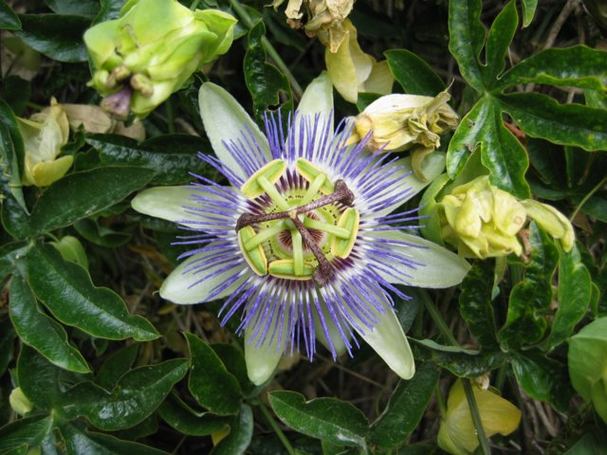
Scaling Down a Picture
passionFlower.jpg is 640pixels wide and 480 pixels high
If we copy every other pixel we will have a new picture with width (640 / 2 = 320) and height (480 / 2 = 240)
0 | 1 | 2 | 3
4 | 5 | 6 | 7
8 | 9 | 10 | 11
12 | 13 | 14 | 15
0 | 2
8 | 10

Slide 5
Scaling Down Algorithm
Create the target picture
Invoke the method on the target picture
  Create the source picture
  Loop with source x starting at 0 and target x starting at 0 as long as < source width
    Increment the source x by 2 each time through the loop, increment the target x by 1
    Loop with source y starting at 0 and target y starting at 0 as long as < source height
      Increment the source y by 2 each time through the loop, increment the target y by 1
        Copy the color from the source to target pixel

Slide 6
Scaling Down Method
public void copyFlowerSmaller()
{
Picture flowerPicture =
new Picture(
FileChooser.getMediaPath(“passionFlower.jpg"));
Pixel sourcePixel = null;
Pixel targetPixel = null;
// loop through the columns
for (int sourceX = 0, targetX=0;
sourceX < flowerPicture.getWidth();
sourceX+=2, targetX++)
{

Slide 7
Scaling Down Method - Continued
// loop through the rows
for (int sourceY=0, targetY=0;
sourceY < flowerPicture.getHeight();
sourceY+=2, targetY++)
{
sourcePixel =
flowerPicture.getPixel(sourceX,sourceY);
targetPixel = this.getPixel(targetX,targetY);
targetPixel.setColor(sourcePixel.getColor());
}
}
}
Notes:
sourceY+= 2 means the same as sourceY = sourceY + 2;

Slide 8
Trying Copy Flower Smaller
Create a new picture half the size of the original picture (+ 1 if odd size)
  Picture p1 = new Picture(320,240);
Copy the flower to the new picture
  p1.copyFlowerSmaller();
Show the result
  p1.show();

Slide 9
Thinking Through Scaling Up
Copy each pixel in the source multiple times to the target
  Source (0,0) Target (0,0)
  Source (0,0) Target(1,0)
  Source (1,0) Target(2,0)
  Source (1,0) Target(3,0)
  Source (2,0) Target(4,0)
  Source (2,0) Target(5,0)
  Source (0,0) Target(0,1)
  Source (0,0) Target(1,1)
0
1
2
0
1 | 2 | 3
4 | 5 | 6
1
0
1
2
3
4
5
0
1 | 1 | 2 | 2 | 3 | 3
1 | 1 | 2 | 2 | 3 | 3
4 | 4 | 5 | 5 | 6 | 6
4 | 4 | 5 | 5 | 6 | 6
1
2
3
Notes:
What could we add to source x and source y so that it is 0 twice, then 1 twice, then 2 twice, etc.
Remember that 0.5 is 0 when you cast to integer.

Slide 10
Scaling Up Algorithm
Create the target picture
Invoke the method on the target picture
  Create the source picture
  Loop with source x starting at 0 and target x starting at 0 as long as < source width
    Increment the source x by 0.5 each time through the loop, increment the target x by 1
    Loop with source y starting at 0 and target y starting at 0 as long as < source height
      Increment the source y by 0.5 each time through the loop, increment the target y by 1
        Copy the color from the source to target pixel
Notes:
The source x and y will need to be double variables. Cast them to int to lose the fractional part to get the pixel x and y.

Slide 11


Scaling Up Exercise
Write a method copyFlowerBigger to scale up the picture flower1.jpg when you copy it to 640x480.jpg
Save the result to a file using
  pictureObj.write(“file”);

Slide 12

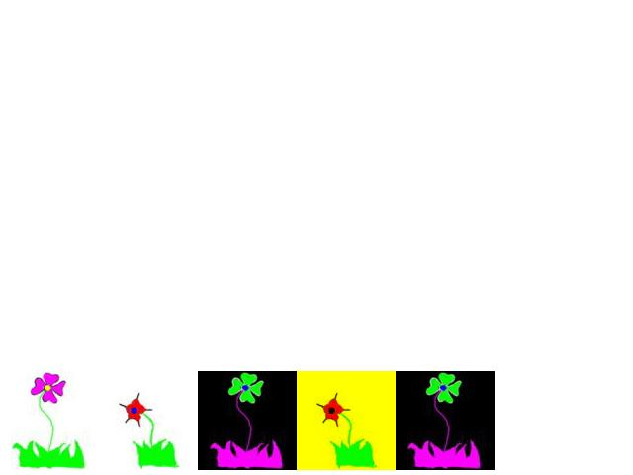
Create a Collage
One of the things that you can do with pictures is create a collage
  There are two pictures of flowers
    flower1.jpg
    flower2.jpg
  Both pictures are 100 pixels wide
  The target picture is created from file 640x480.jpg
The Picture’s bottom left is at x = 0 y = height - 5

Slide 13
Create Collage Algorithm
Create the target picture object
  Using the 640x480 file
Invoke the method on the target picture
  Create the flower picture objects
    using flower1.jpg as source1Picture
    using flower2.jpg as source2Picture
  Set targetBottomY to the targetPicture height – 5
    5 pixels from bottom of picture

Slide 14
Create Collage Algorithm - Cont
  Copy all of source1Picture to the current picture starting at x=0, y=targetBottomY – source1Picture’s height
  Copy all of source2Picture to the current picture starting at x=100, y = targetBottomY – source2Picture’s height
  Negate source1Picture
  Copy all of source1Picture to the current picture starting at x=200, y= targetBottomY – source1Picture’s height
  Clear the blue from source2Picture
  Copy all of source2Picture to the current picture starting at x=300, y= targetBottomY – source2Picture’s height
  Copy all of source1Picture to the current picture starting at x=400, y=targetBottomY – source1Picture’s height

Slide 15
Create Flower Collage Method
public void createFlowerCollage()
{
Picture source1Picture =
new Picture(FileChooser.getMediaPath("flower1.jpg"));
Picture source2Picture =
new Picture(FileChooser.getMediaPath("flower2.jpg"));
int targetBottomY = this.getHeight() - 5;
// copy source1Picture to 0, targetBottomY - height
this.copy(source1Picture,0,0,
source1Picture.getWidth(),
source1Picture.getHeight(),
0,targetBottomY -
source1Picture.getHeight());
// copy source2Picture to 100, targetBottomY - height
this.copy(source2Picture,0,0,
source2Picture.getWidth(),
source2Picture.getHeight(),
100,targetBottomY -
source2Picture.getHeight());

Slide 16
Create Flower Collage Method - Cont
// negate the source1Picture
source1Picture.negate();
// copy negated source1Picture to 200
this.copy(source1Picture,0,0,
source1Picture.getWidth(),
source1Picture.getHeight(),
200,targetBottomY -
source1Picture.getHeight());
// clear the blue from source 2 picture
source2Picture.clearBlue();
// copy source2Picture to 300
this.copy(source2Picture,0,0,
source2Picture.getWidth(),
source2Picture.getHeight(),
300,targetBottomY -
source2Picture.getHeight());
// copy negated source1Picture to 400
this.copy(source1Picture,0,0,
source1Picture.getWidth(),
source1Picture.getHeight(),
400,targetBottomY -
source1Picture.getHeight());
}

Slide 17
Testing createFlowerCollage
String file = FileChooser.getMediaPath(“640x480.jpg”);
Picture p = new Picture(file);
p.show();
p.createFlowerCollage();
p.repaint();

Slide 18
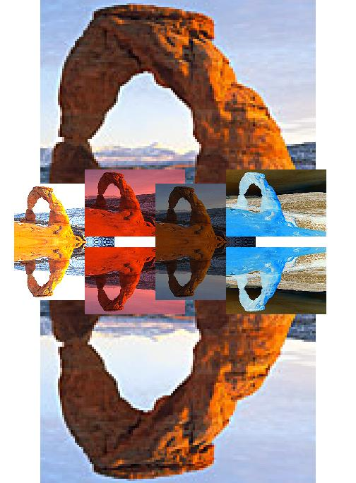
Create Collage Exercise
Try creating a collage
  At least 4 copies of an image in it
  The original image and 3 changes to the original image
    Scale, rotate, crop, change colors
  Then mirror the whole picture horizontally
  Save your collage using
    pictureObj.write(fileName);
Notes:
See http://coweb.cc.gatech.edu/cs1315/916 for some examples from Georgia Tech students.

Slide 19
Summary
You can scale a picture down
  By not copying all the pixels
    Increment the source index by a number > 1
You can scale a picture up
  By copying the source pixels more than one time
    You can increment the source index by 0.5 and then cast it to integer
You can create an image collage
  Using the methods we have written

